Slide 1

Sensors and Actuators
Industrial IoT
Software and Services Group
IoT Developer Relations, Intel

Slide 2
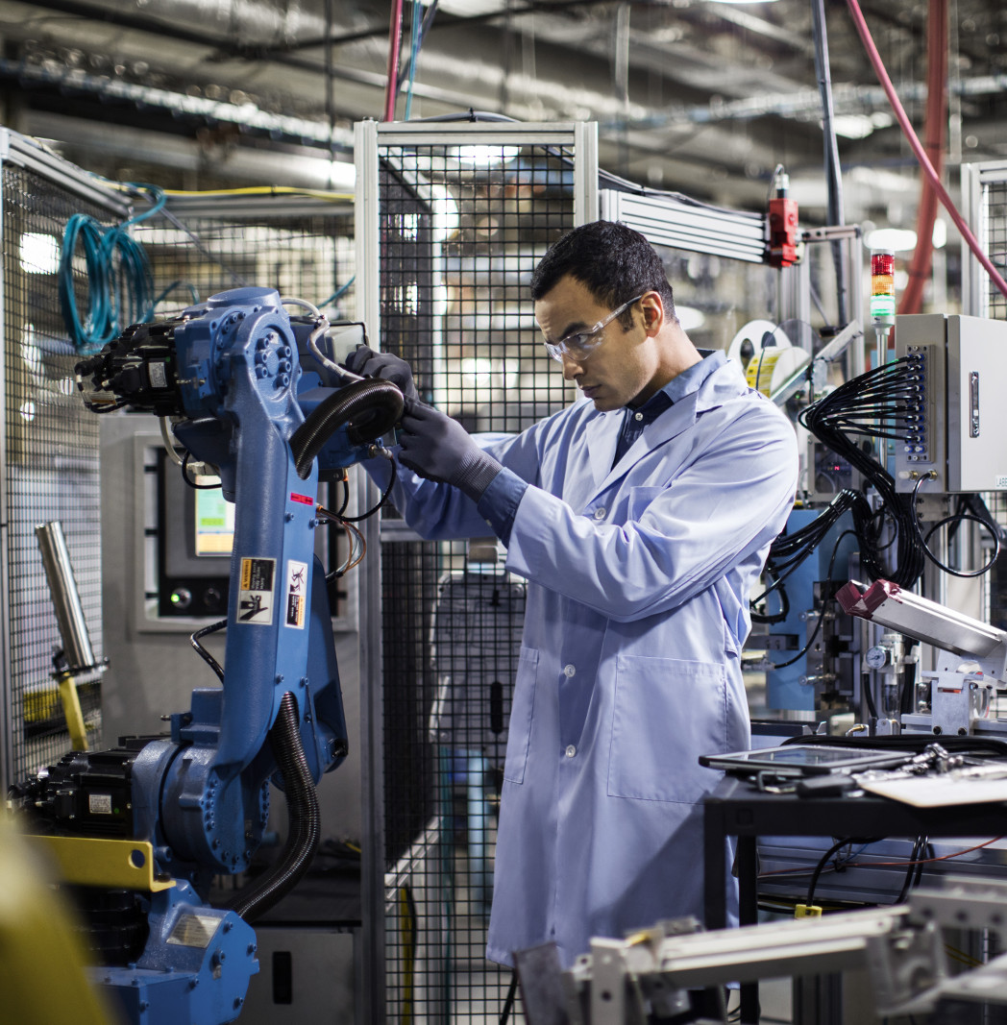
Cyber-Physical
Cyber-Physical Systems (CPS) are integrations of computation, networking, and physical processes.
Physical processes affect the computation model of the process and vice-versa.
The economic impact of cyber-physical systems is vastly greater than what has been realized. Major investments are being made worldwide to develop the technology.

Slide 3
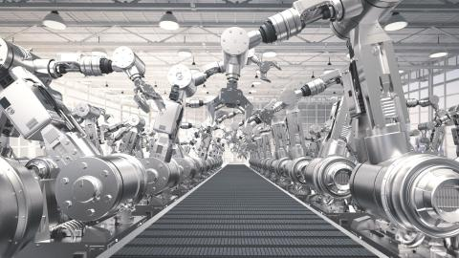
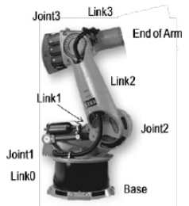
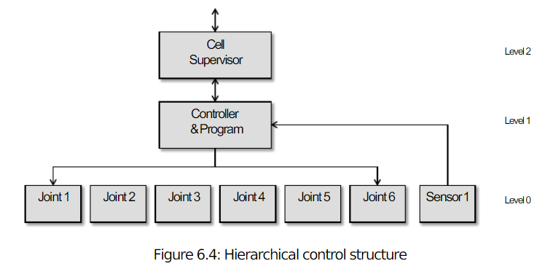
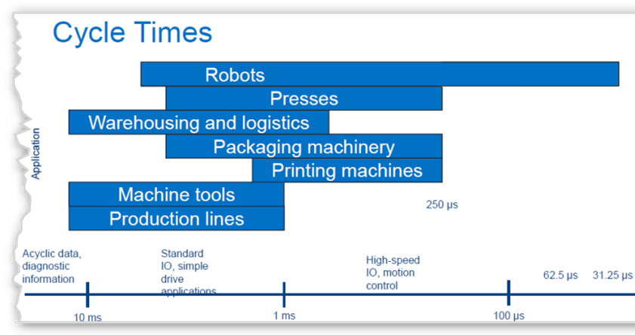

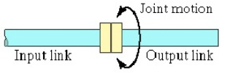
Sensing for Automation and Robotics
Microprocessor-based controllers are regularly used to perform robot joint movements control.
Typically the controller is organized in a hierarchical fashion:
Joint can loop-control data individually
Supervisory controller coordinating the combined actuations of the joints according to the loop-control of the robot program for given cycle-time.
Internal & External Sensors are used to monitor and control the various joints of the robot; they form a feedback control-loop with the robot controller.
Groover, M. P. (2008),
Automation, Production Systems, and Computer-Integrated Manufacturing, 3rd ed., Chapter 8
Notes:
The SCARA body-and-arm configuration typically does not use a separate wrist assembly; its usual operative environment is for insertion-type assembly operations where wrists joints are unnecessary. The other four body-and-arm configurations more-or-less follow the wrist-joint configuration given above, deploying various combinations of rotary joints type R and T
An example is outlined below: TLR : TR
Body-and-arm manipulator:
T = Twisting joint for joint 1;
L = Linear joint for joint 2;
R = Rotational joint for joint 3.
Wrist:
T = Twisting joint for joint 4;
R = Rotational joint for joint 5
The combination of drive system, sensors, and feedback control system determines the dynamic response characteristics of the manipulator. Speed in robotic terms refers to the absolute velocity of the manipulator at its end-of-arm.
Speed of response influence’s the robot’s cycle time, which in turn affects the production rate that can be achieved.
EXAMPLE: A robot performs a loading and unloading operation for a machine tool.
The work cycle consists of the following sequence of activities:
Robot reaches and picks part from incoming conveyor and loads into fixture on-machine tool. (Time=5.5 sec)
Machining cycle (automatic). (Time=33.0 sec)
Robot reaches in, retrieves part from machine tool, and deposits it onto outgoing conveyor. (Time=4.8 sec)
Move back to pickup position. (Time=1.7 sec)
The activities are performed sequentially as listed.
Every 30 work-parts, the cutting tools in the machine must be changed. This irregular cycle takes 3.0minutes to accomplish. The uptime efficiency of the robot is 97%; and the uptime efficiency of the machine tool is 98%, not including interruptions for tool changes. These two efficiencies are assumed not to overlap (i.e., if the robot breaks down, the cell will cease to operate, so the machine tool will not have the opportunity to break down; and vice versa).
Downtime results from electrical and mechanical malfunctions of the robot, machine tool, and fixture. Determine the hourly production rate, taking into account the lost time due to tool changes and the uptime efficiency.
Solution
Tc = 5.5 + 33.0 + 4.8 + 1.7 = 45 sec/cycle Tool change time
Ttc = 180 sec/30 pc = 6 sec/pc
Robot uptime E = 0.97, lost time = 0.03.
Machine tool uptime E = 0.98, lost time= 0.02.
These two inefficiencies are assumed not to overlap in the following solution.
Tc+ Ttc/30 = 45 + 6 = 51 sec = 0.85 min/pc
Rc= 60/0.85 = 70.59 pc/hr
Accounting for uptime efficiencies,
Rp= 70.59(1.0 0.03 0.02) = 67.06 pc/hr

Slide 4
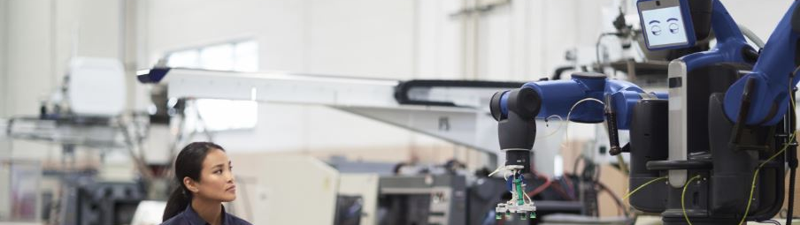
PROTOTYPING WITH Sensors and Actuators
https://software.intel.com/en-us/industrial-sensors-with-upm-support

Slide 5
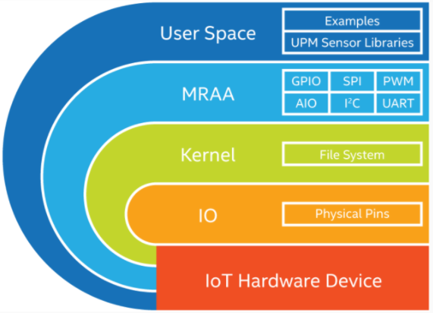
MRAA - An I/O Library for the Internet of Things
Provides I/O abstraction across both Intel and non-Intel (community added) MCU boards, UNIX boards and IoT Gateways.
X86
Minnowboard
NUC
UP2 Board
Intel® NUC
UP* and UP Squared*
Arduino* and Genuino* 101
ARM
Raspberry Pi
Banana Pi
Beaglebone Black
phyBOARD-Wega
96Boards
https://github.com/intel-iot-devkit/mraa

Slide 6
Introducing Intel IoT Device Libraries: MRAA and UPM
libmraa aka “MRAA”: https://github.com/intel-iot-devkit/mraa
Open Source IO Libs (UART, SPI, GPIO, I2C, AIO)
Provides higher level abstraction making hardware IO easier to use from userspace
Enables portability between devices
Supports Intel® Galileo and Intel® Edison boards, MinnowBoard MAX, etc.
UPM: https://github.com/intel-iot-devkit/upm
High level library repository of sensor drivers
Sensors/Actuators using libmraa
Making it easy to control
Expanding support to Industrial grade sensors
UPM and MRAA make it easy to build IoT projects!

Slide 7


























Making Sensors and Actuators Accessible
Support for Multiple Operating Systems
Support for Multiple Languages
Maker Sensors
Industrial Sensors

Slide 8
MRAA & UPM – Architecture
UPM Module
UPM Module
UPM Module
UPM Module
UPM C++ Interfaces
iTemp
iGyro
iCompass
iAccel
iMotor
iDisplay
iLoRaWAN
iLTEClient
Others …
iSensor
iActuator
iRadio
iio
UPM C generic interfaces
Mraa C/C++ APIs
Libmodbus
Bacnet
Others …
GPIO
i2c
SPI
UART
PWM
Linux Kernel

Slide 9
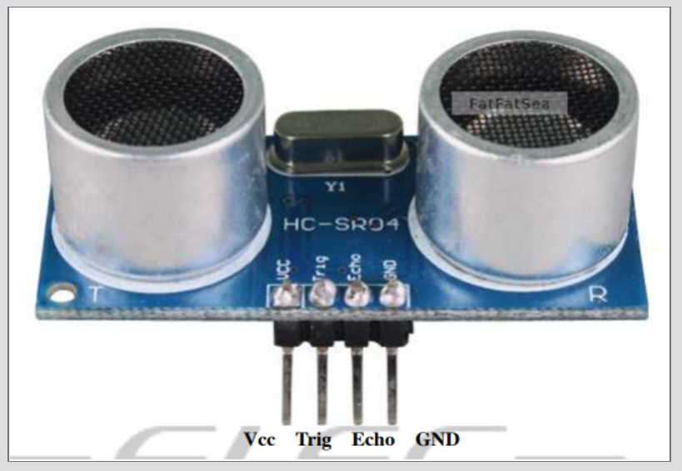
MRAA and UPM Benefit
Let’s see what kind of advantage MRAA, UPM brings sensor software development with Ultrasound Sensor example
GOTO: https://github.com/SSG-DRD-IOT/ultrasound_sensor (https://goo.gl/cbQmcH)

Slide 11
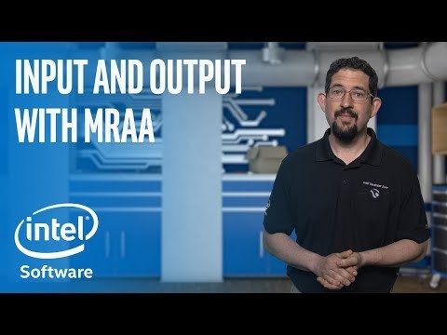
MRAA, UPM Introdction video

